Slide 1
NFL Draft Visuals

Slide 2
The Question???
Our overall question was:
“Is it a good choice for an NFL team to choose a Quarterback in the first round of the NFL Draft?”
From there we used many factors to determine if this was true.

Slide 3
Talent evaluators in the NFL value physical traits and college statistics to determine which round a player should be drafted.
We are trying to determine if these factors are indicative of an NFL players career success.

Slide 4
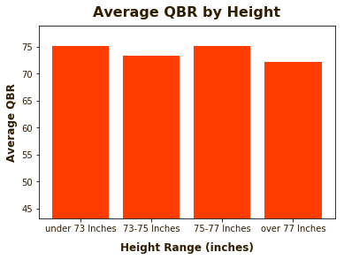

Slide 5
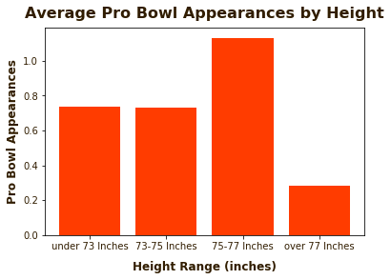

Slide 6
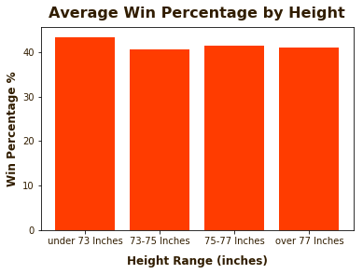

Slide 7
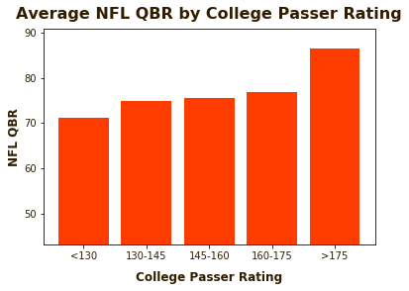

Slide 8
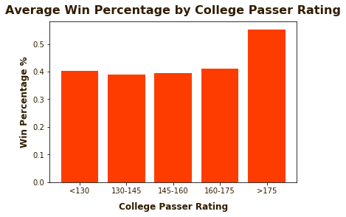

Slide 9
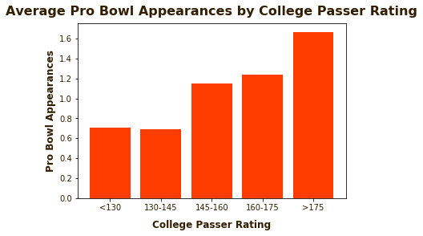

Slide 10
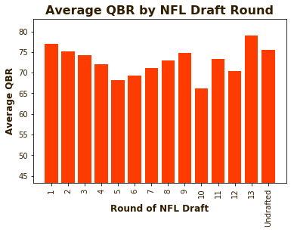

Slide 11
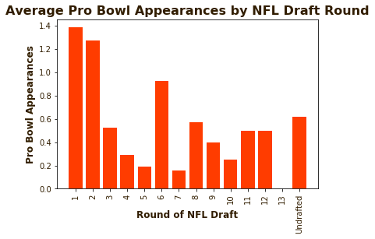

Slide 12
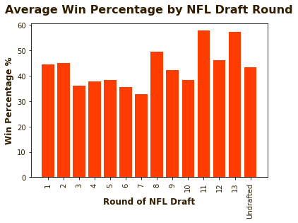

Slide 13
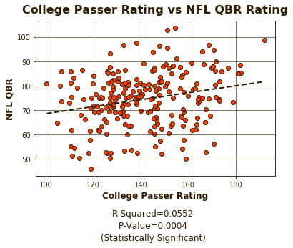

Slide 14
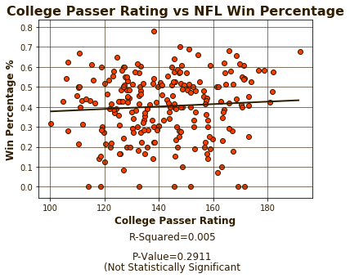

Slide 15
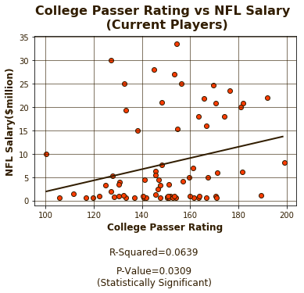

Slide 16
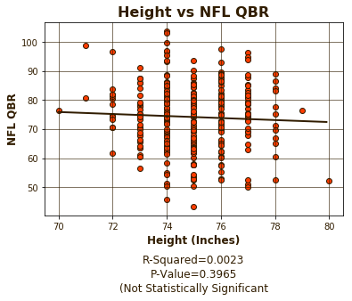

Slide 17
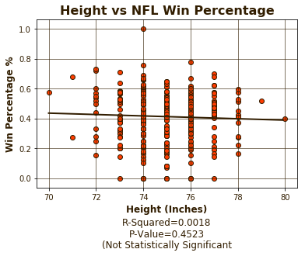

Slide 18
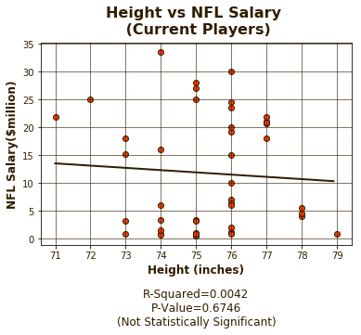

Slide 19
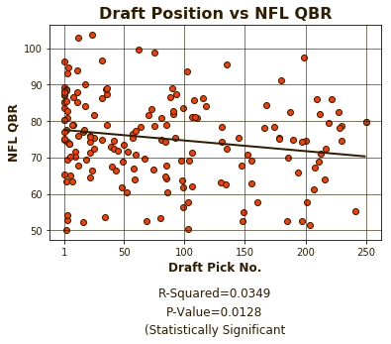

Slide 20
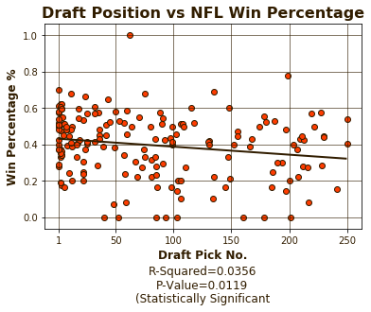

Slide 21
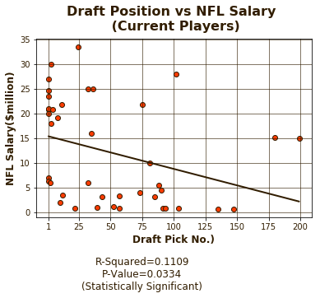

Slide 22
The Results?
From our findings we are confident that College Stats, QBR, Pro Bowl Appearances are good indicators of a players success in the NFL.
Will Baker Mayfield be a good Quarterback?

Slide 23
Other Questions?
How much does a college football player’s schedule effect their player stats?
Should we have looked at a different physical trait besides height?
How do college injuries and injuries once in the NFL change these stats?

